Slide 1
CSE 546 Final Project- MARl
Suraj Suraj
Sumeet Aher

Slide 2
Background
- Specifically, first, the learning goals in MARL are multi-dimensional, as the objectives of all agents are not necessarily aligned, which brings up the challenge of dealing with equilibrium points, as well as some additional performance criteria beyond return-optimization, such as the efficiency of communication/coordination. Moreover, as all agents are improving their policies according to their own interests concurrently, the environment faced by each agent becomes non-stationary. This breaks or invalidates the basic framework of most theoretical analyses in the single-agent setting. Furthermore, the joint action space that increases exponentially with the number of agents may cause scalability issues, known as the combinatorial nature of MARL. Additionally, the information structure, i.e., who knows what, in MARL is more involved, as each agent has limited access to the observations of others, leading to possibly suboptimal decision rules locally.

Slide 3
Project Description
What are we aiming to do with this project?
Running experiments to to understand the behavior of multiple Agents (2 in this case) in a grid environment
Different possible communication channels between agents and understanding its impact on reward collection
Hide & Seek

Slide 4
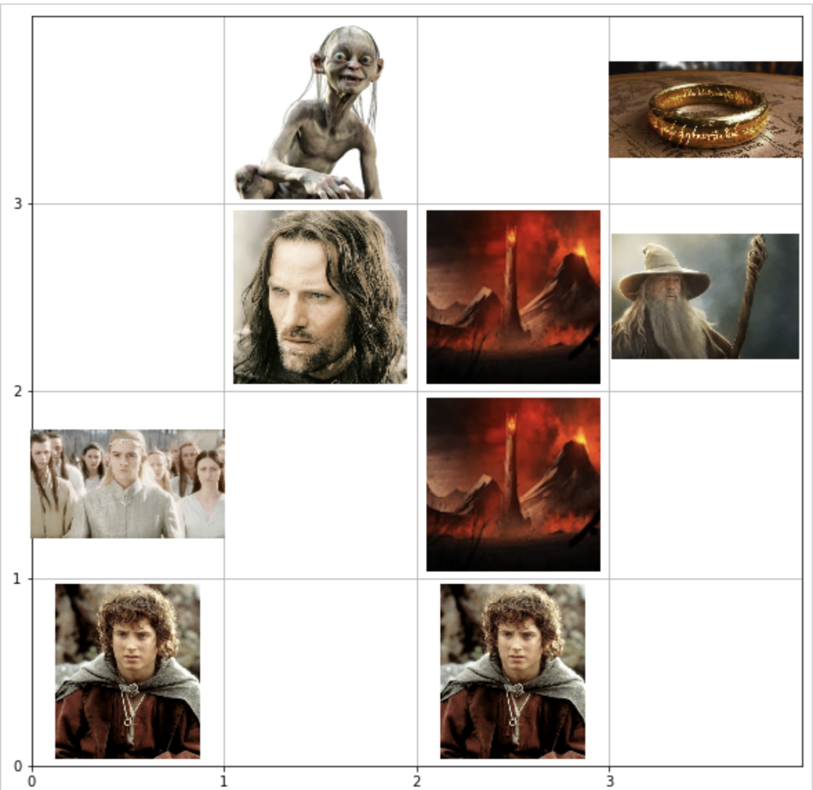
Environment
ENV – PART 1
ENV - PART 2
-2
-4
-4
+20
-4
+20
+2
+ 4
+ 10
+ 10
+ 2
+ 10
-4
-2

Slide 5
Implementation and Experiments(PART 1) – Q Learning
Training both the agents with sequential step where agent0 will take the first step and then agent1 and independent q_table. [V1]
Training both the agents with randomized steps where agent0 and agent1 will take the 1st step interchangeably with independent q_table [V2]
Modifying V1 with a common q_table for both agents [V3]
Modifying V2 with a common q_table for both agents [V4]

Slide 6
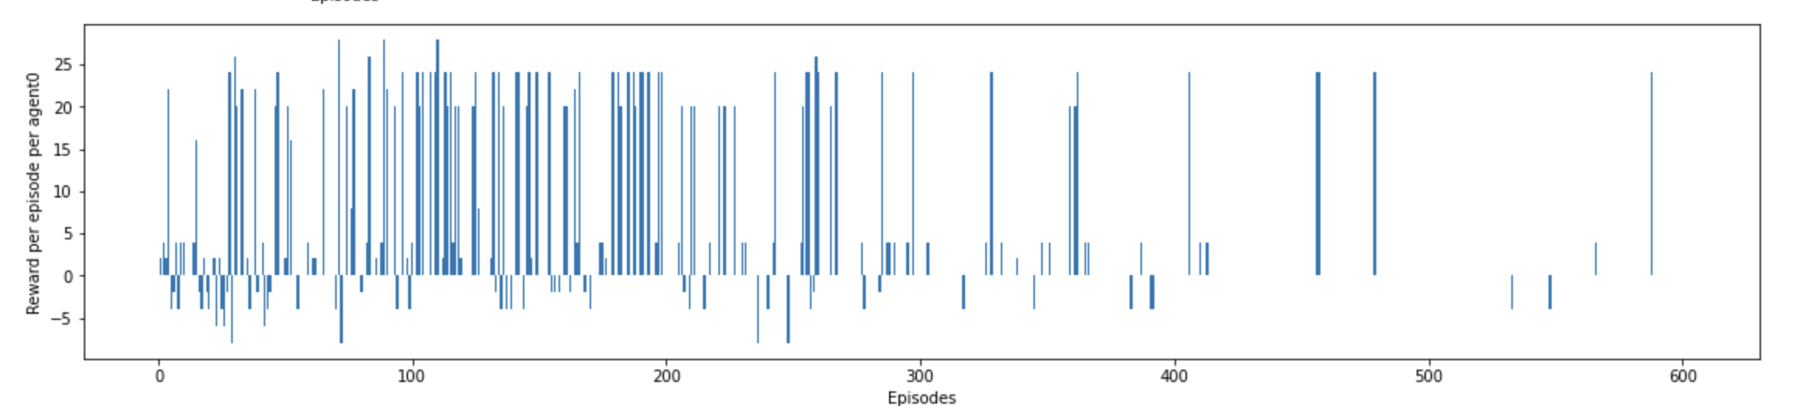
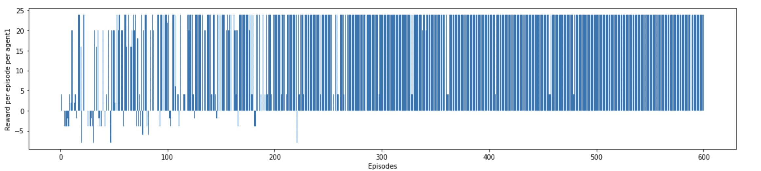
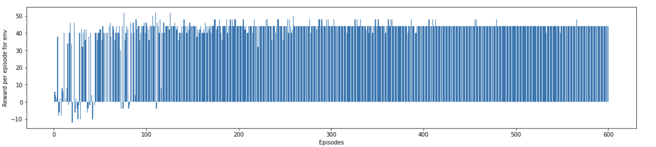
Results
Environment
Fig. P1

Slide 7
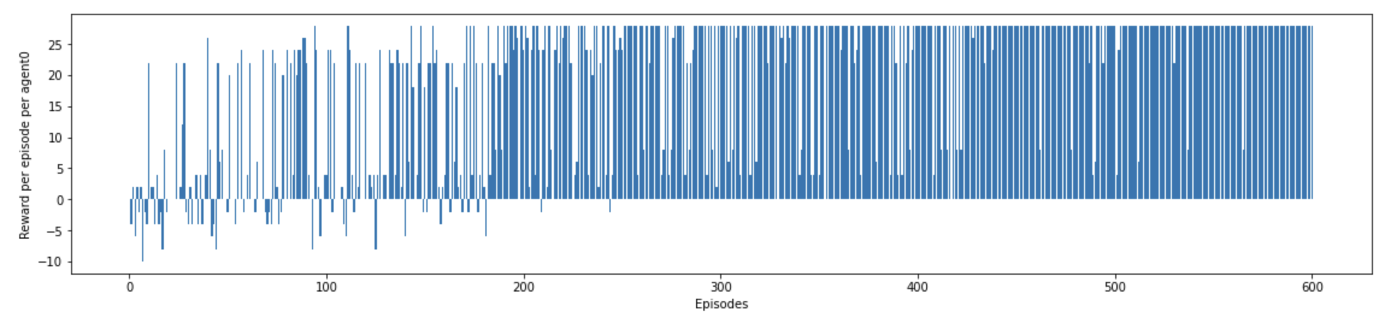
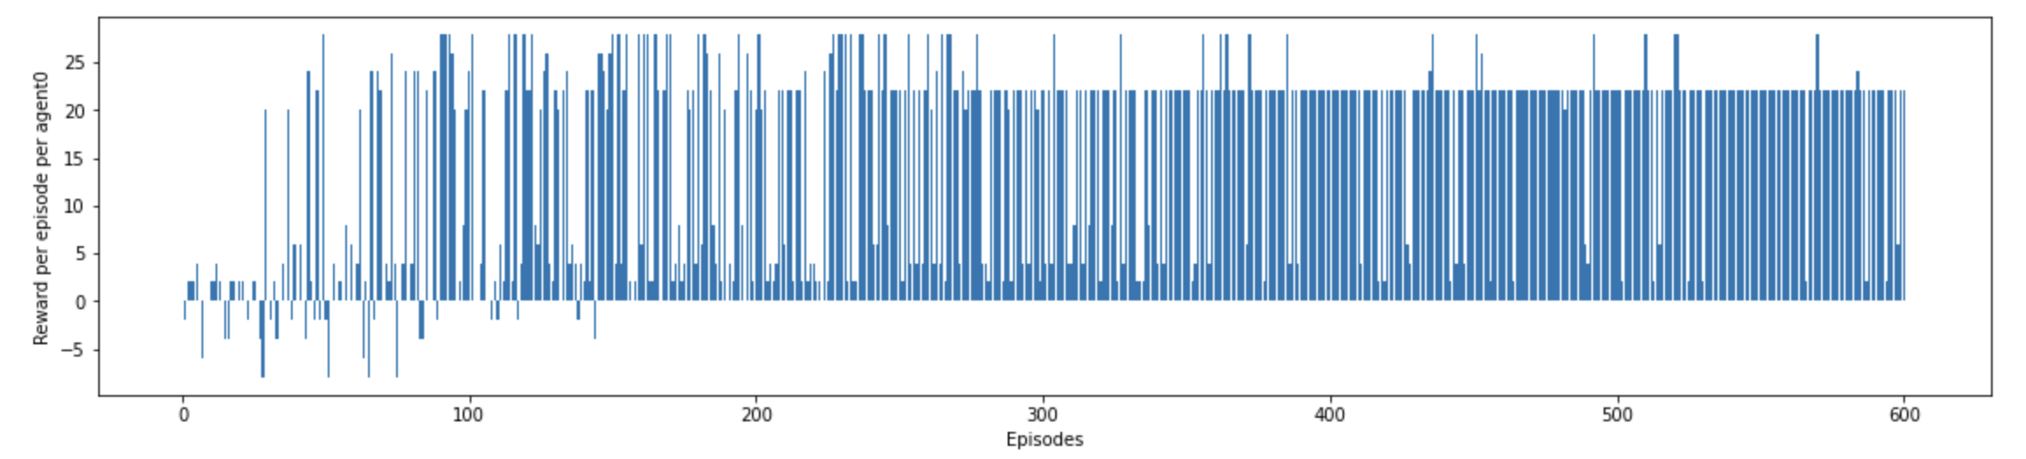
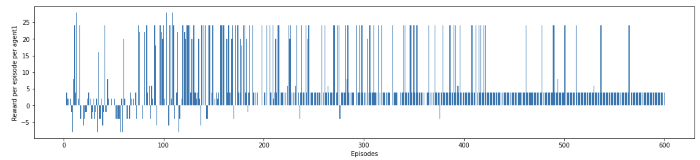
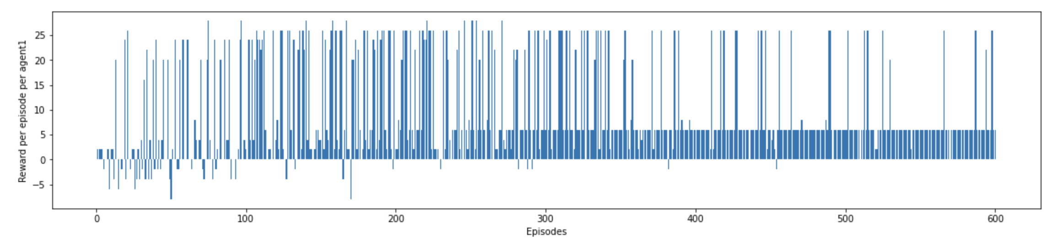
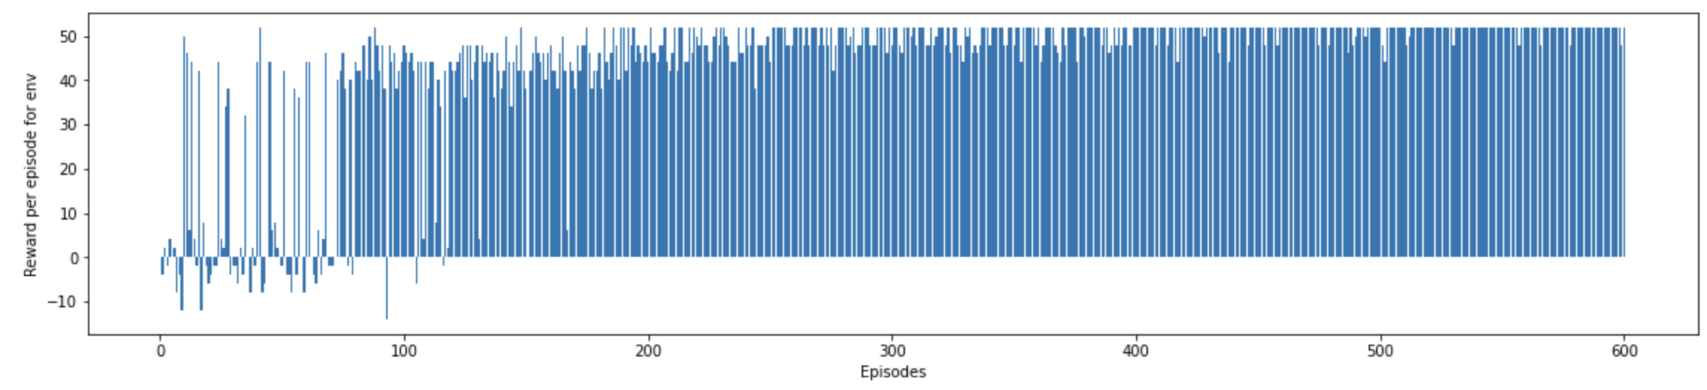
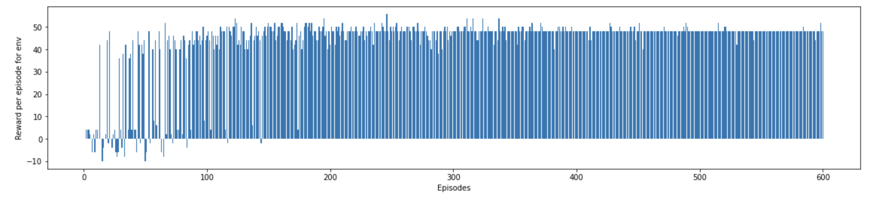
Results
Agent 1
Agent 2
Team
Reward
Fig. P1_V1
Fig. P1_V3

Slide 8
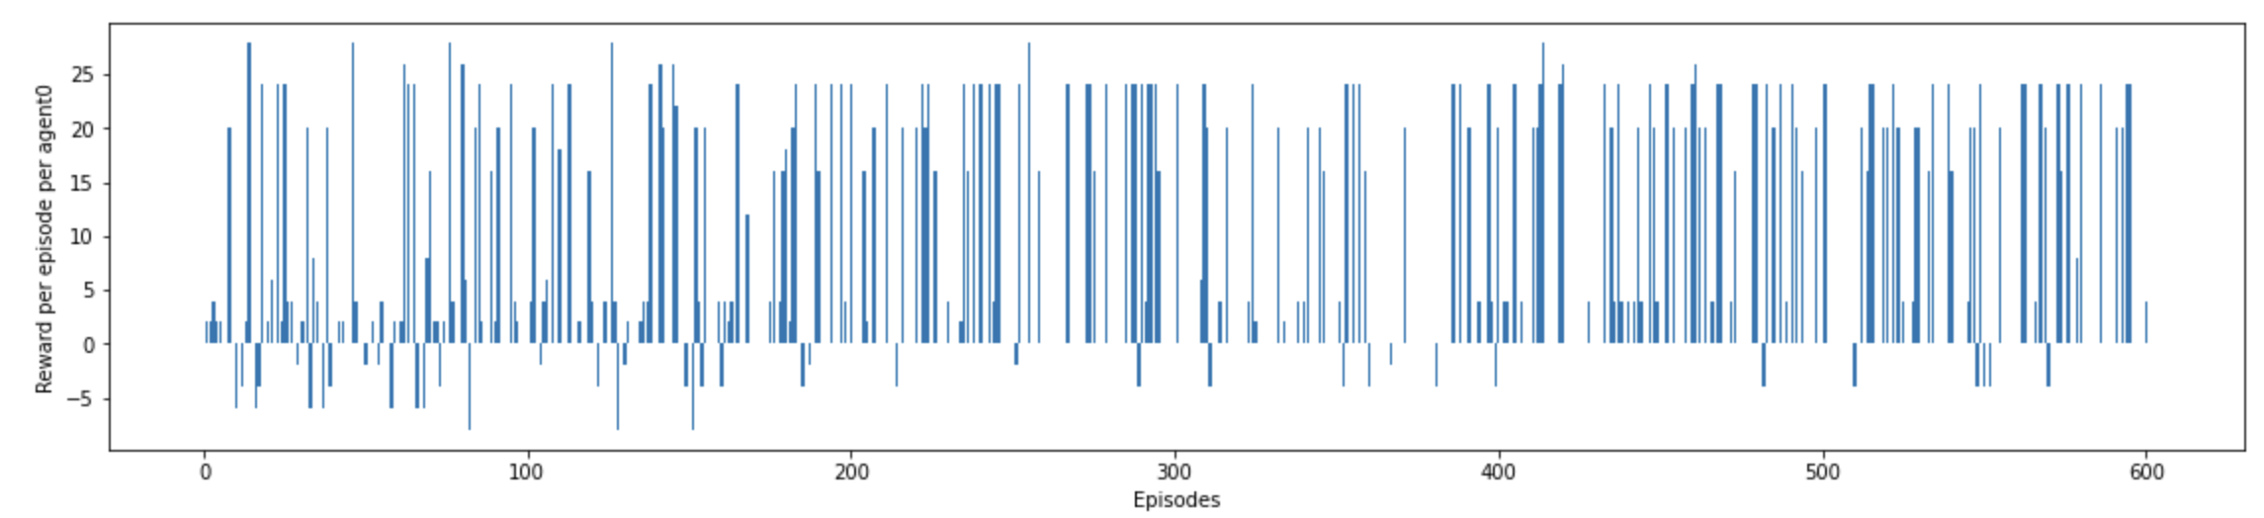
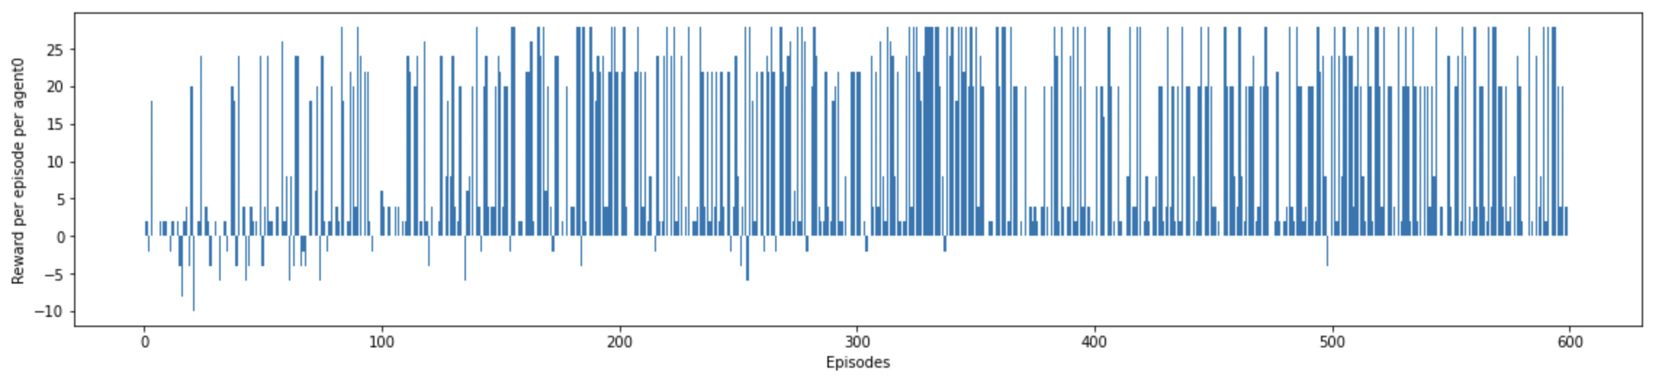
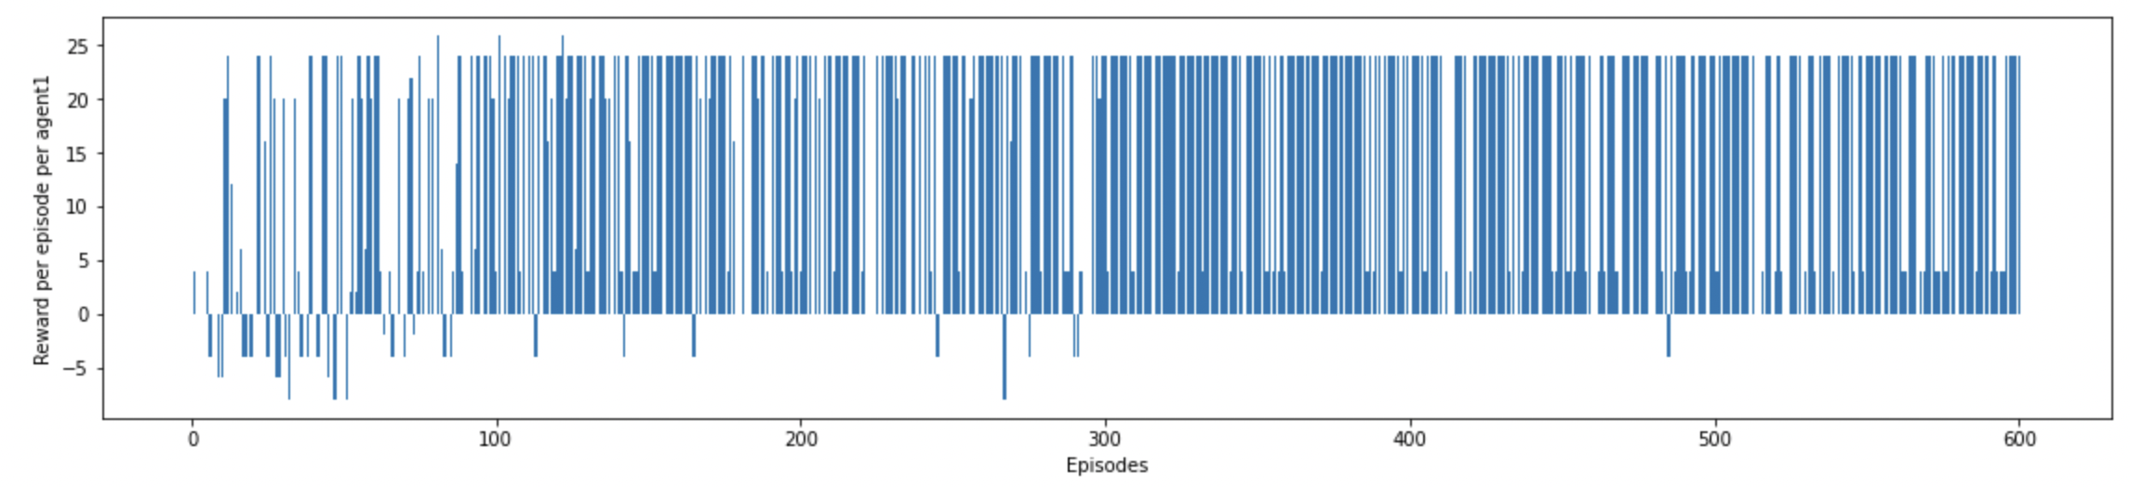
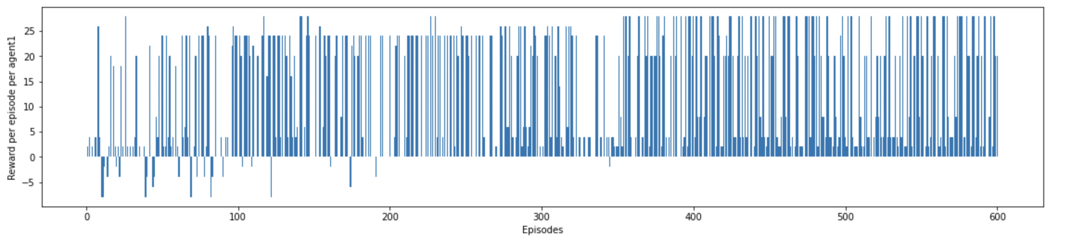
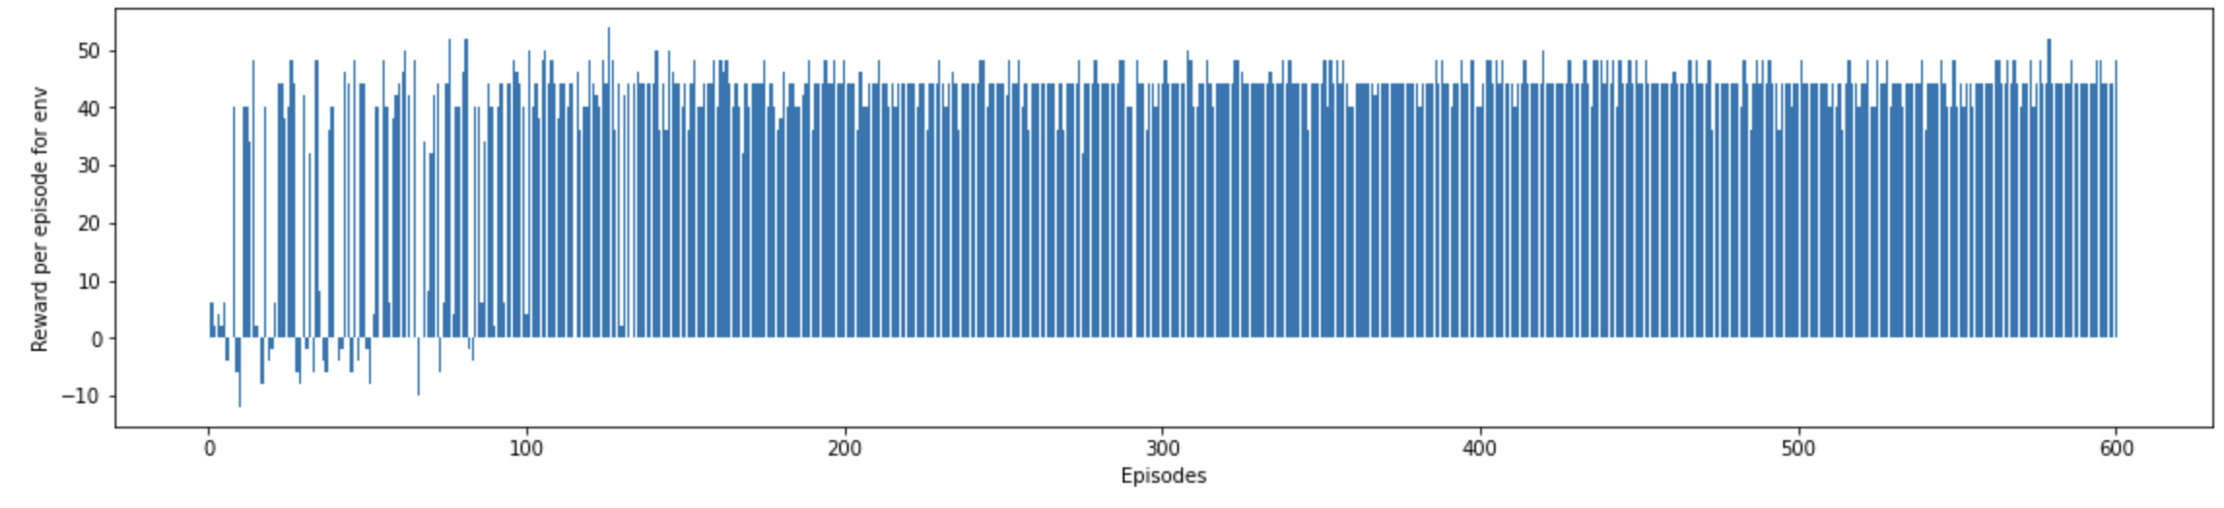
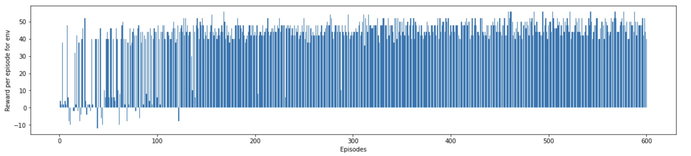
Results
Agent 1
Agent 2
Team
Reward
Fig. P1_V2
Fig. P1_V4

Slide 9
Experiments(PART 2) - DQN Learning
Training both the agents with sequential step where agent0 will take the first step and then agent1 and independent DQN network. [P2_V1]
Training both the agents with sequential step where agent1 will take the first step and then agent0 and independent DQN network. [P2_V2]
Training both the agents with randomized steps where agent0 and agent1 will take the steps interchangeably with independent DQN network [P2_V3]
Modifying P2_V1 with a common DQN for both agents [P2_V4]
Conti…

Slide 10
Training both the agents with sequential step where agent0 will take the first step and then agent1 and independent DQN network but the episode only ends when both agents complete their full episode. [P2_V6]
Training both the agents with sequential step where agent1 will take the first step and then agent0 and independent DQN network but the episode only ends when both agents complete their full episode. [P2_V7]
Training both the agents with randomized steps where agent0 and agent1 will take the steps interchangeably with SAME DQN network [P2_V8]

Slide 11
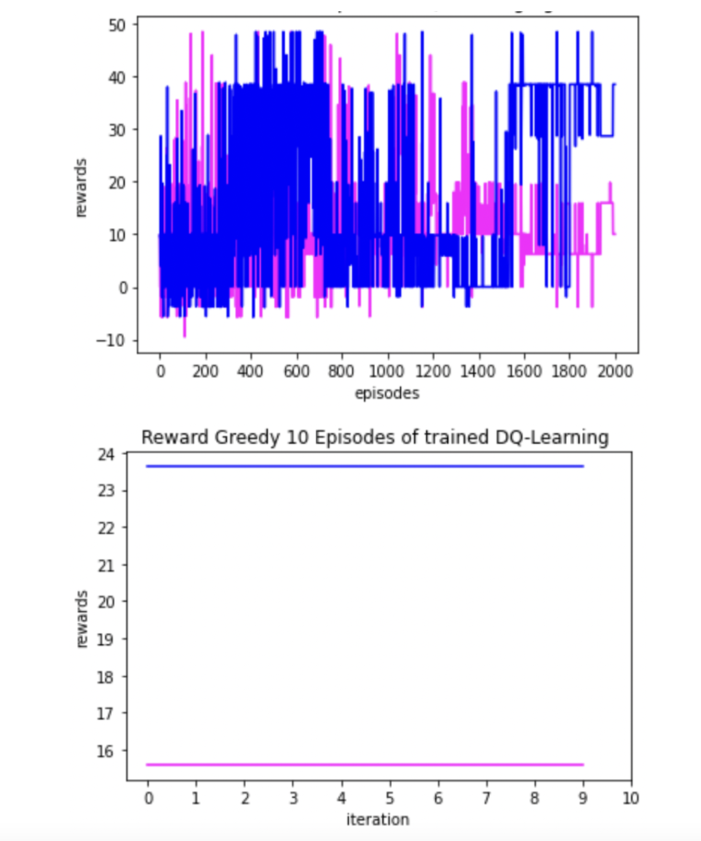
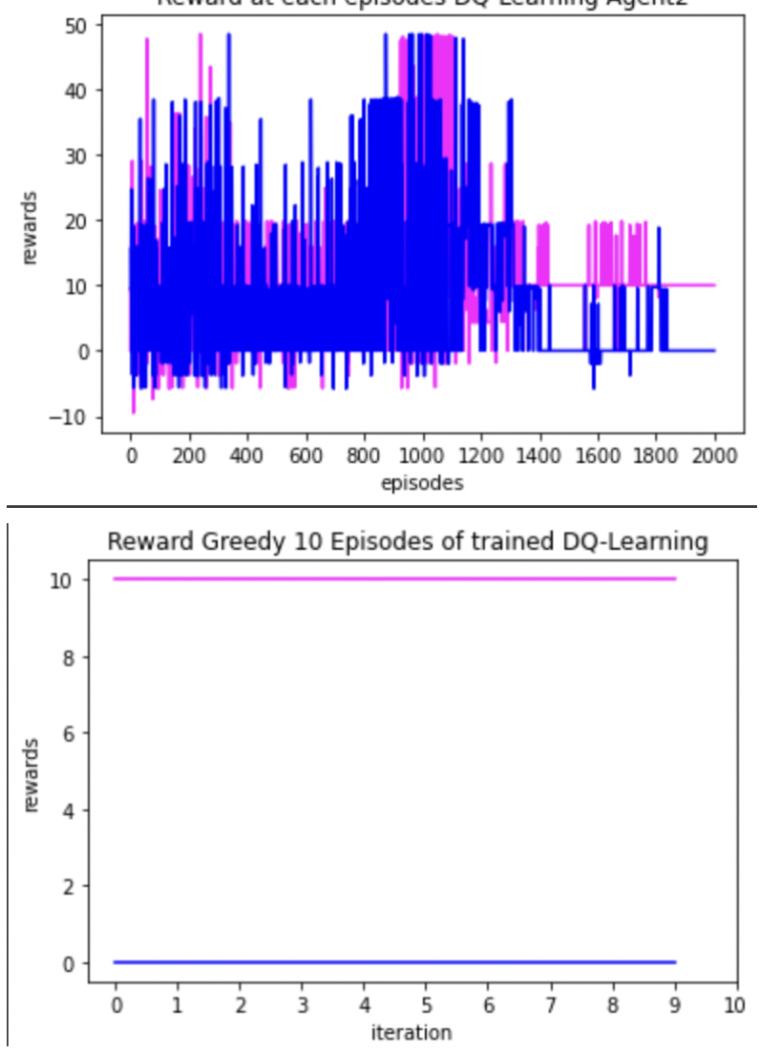
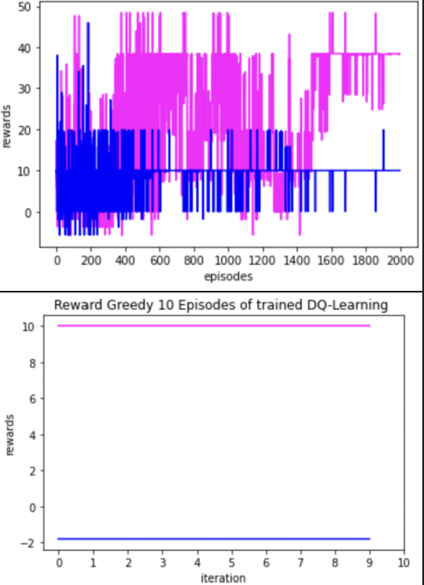
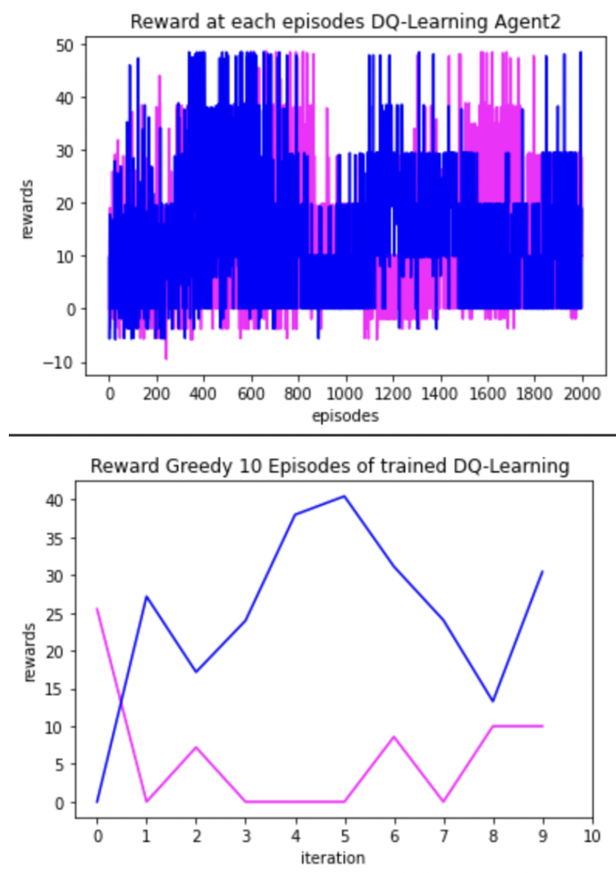
Results
Fig. P2_V1
Fig. P2_V2
Fig. P2_V3
Fig. P2_V4

Slide 12
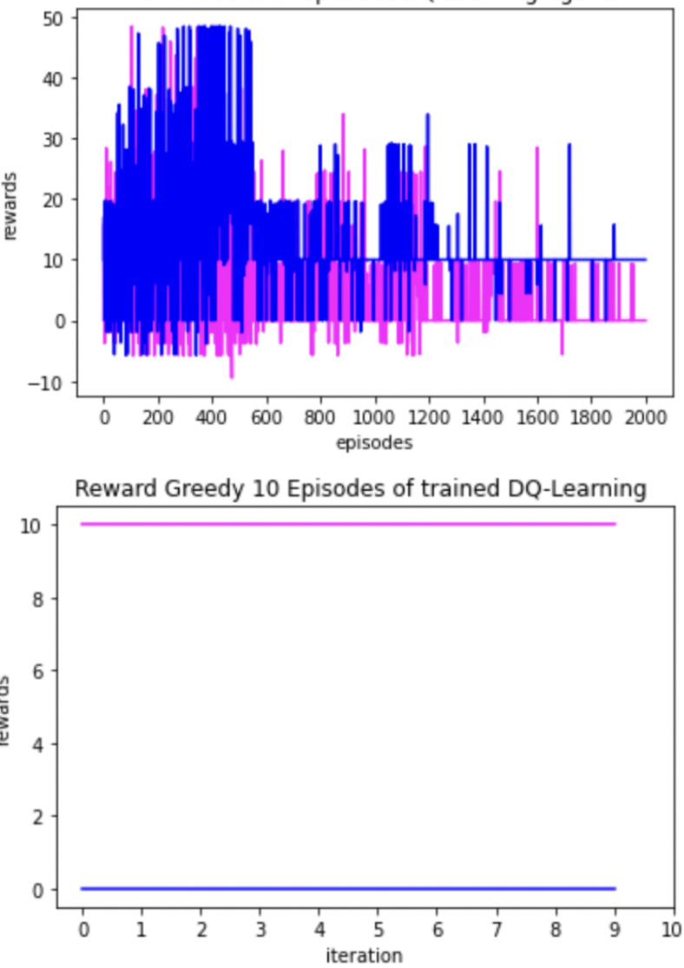
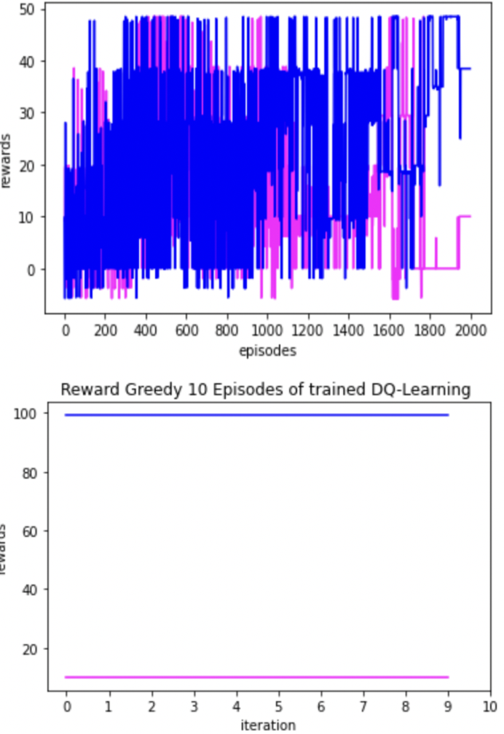
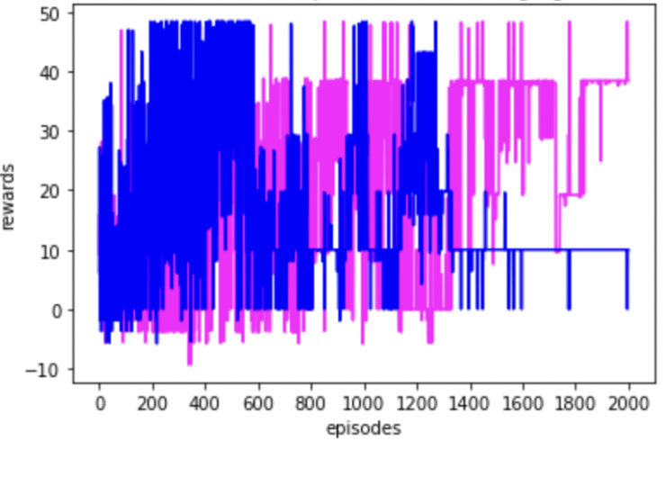
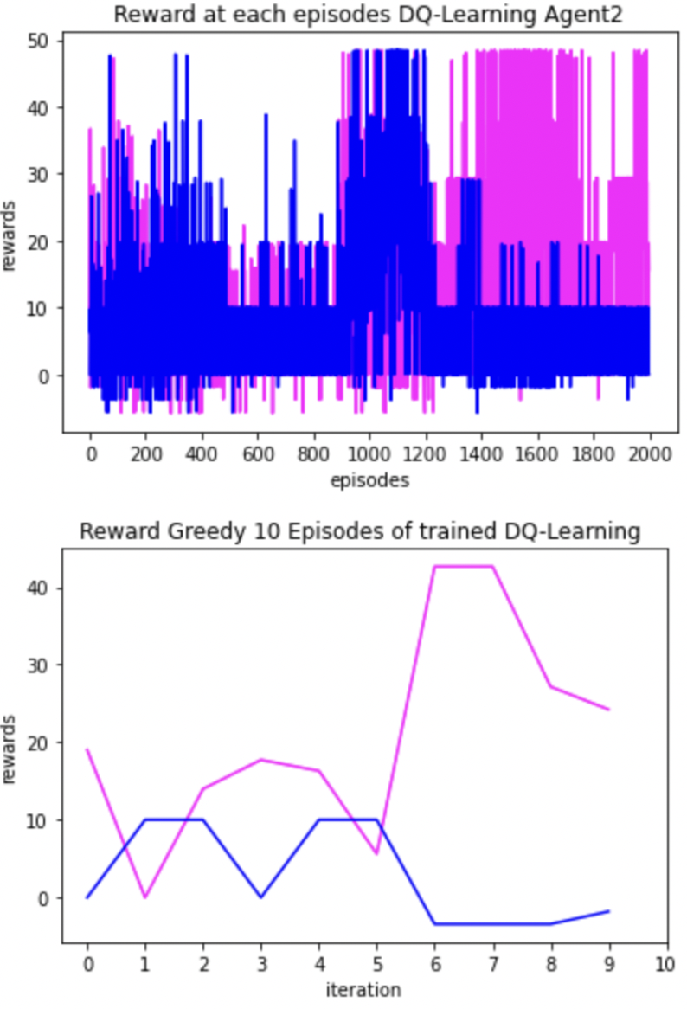
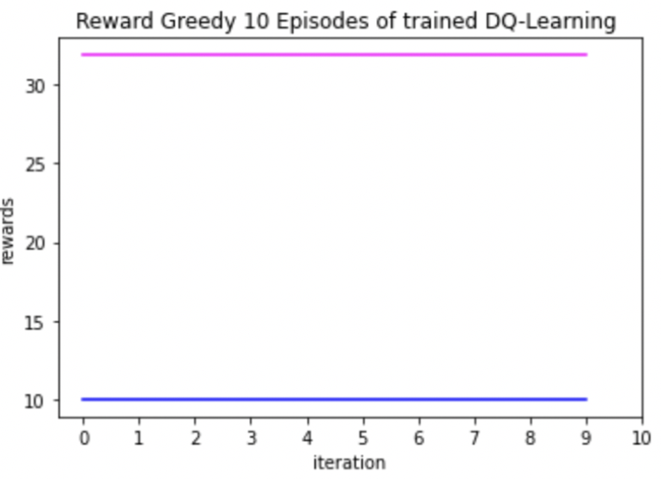
Fig. P2_V5
Fig. P2_V6
Fig. P2_V7
Fig. P2_V8

Slide 13
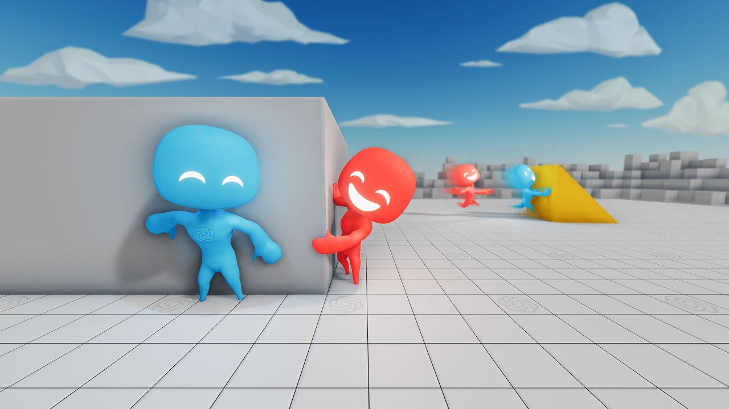
Hide & Seek
Multi Agent: Two Teams
Reward system: +1/-1 and penalty
Observation: Ramp, box, agents
Actions: Glue, Movement, Pull

Slide 14
Contribution
Suraj 40%
Sumeet 40%
Rana 20%

Slide 15
THank You

